Slide 1




HR ANALYTICS

Slide 2
Project Name : HR Analytics
Mentor : Lakshmi Sirisha Pamdipati
Team Members :
Pradeebaa Gurupadmanaban
Vannalu Bhaskar Keerthana
Venkata Sai Gunishetty
Bharadwaj
Varsha Doosakanti
Aravind Reddy
Anil Kumar
Notes:
Project Name :
HR Analytics
Mentor :
Project Members :
Pradeeba
Keerthana Bhaskara Vannala
Venkata Sai Gunishetty
Bharadwaj
Varsha Doosakanti
Aravind Reddy
Anil Kumar
Venkata Sai Gunishetty

Slide 3
INTRODUCTION
HR analytics involves the collection and analysis of HR-related data, including employee data, performance metrics, and other relevant data points. By using advanced analytical tools and techniques, HR analytics provides valuable insights into HR processes and trends, enabling organizations to make more informed decisions about their employees and improve overall performance.

Slide 4
BUSINESS OBJECTIVE
The aim of this project is to analyze employee retention and attrition rates with the organization and provide insights to the HR team for developing effective retention strategies. Through data analysis and visualizations, we will identify factors that contribute to :
Employee turnover and attrition.
Evaluate the effectiveness of existing retention strategies.
To verify the satisfaction level of employee in the organization.
Provide recommendations to improve employee retention.

Slide 5
KPI
Average Attrition rate for all Departments.
Average Hourly rate of Male Research Scientist.
Attrition rate Vs Monthly income stats.
Average working years for each Department.
Job Role Vs Work life balance.
Attrition rate Vs Year since last promotion relation.
Notes:
Average Attrition rate for all Departments
Average Hourly rate of Male Research Scientist
Attrition rate Vs Monthly income stats
Average working years for each Department
Job Role Vs Work life balance
Attrition rate Vs Year since last promotion relation

Slide 6
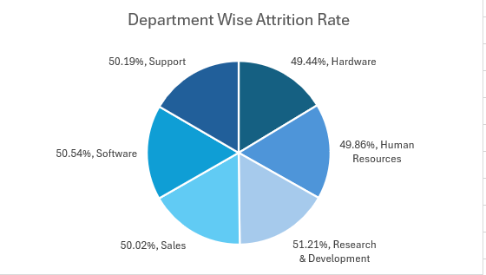
AVERAGE ATTRITION RATE FOR ALL DEPARTMENTS
We can clearly say that attrition rate of employees for every department is almost 50% which indicates that attrition rate of employees does not depends on department. So, irrespective of the department almost 50% of employees are leaving the company. From this calculation and visualization, we concluded that we must make strong strategies to minimize attrition rate and improve our company’s Employee retention so that we can balance the company’s growth and right talent.

Slide 7
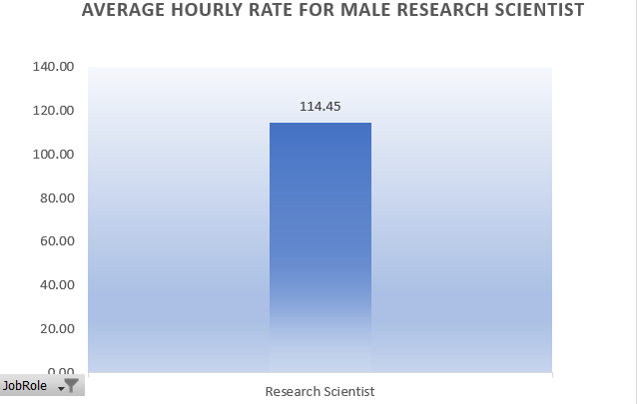
AVERAGE HOURLY RATE OF MALE RESEARCH SCIENTIST
This KPI is to find out the average hourly rate of male research scientists which is 114.45.

Slide 8
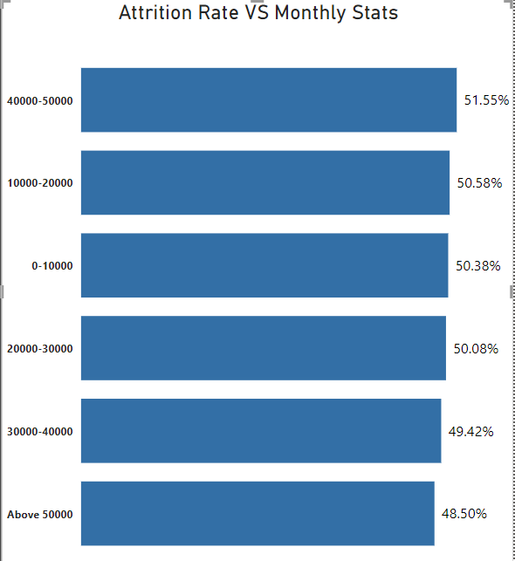
ATTRITION RATE Vs MONTHLY STATS
Based on our analysis and visualization, it is evident that the Hardware Department has the lowest attrition rate of 49.44%, with an average monthly income of Rs. 26,091.20. On the other hand, the Research and Development Department has the highest attrition rate of 51.21%, with an average monthly income of Rs. 26,007.08

Slide 9
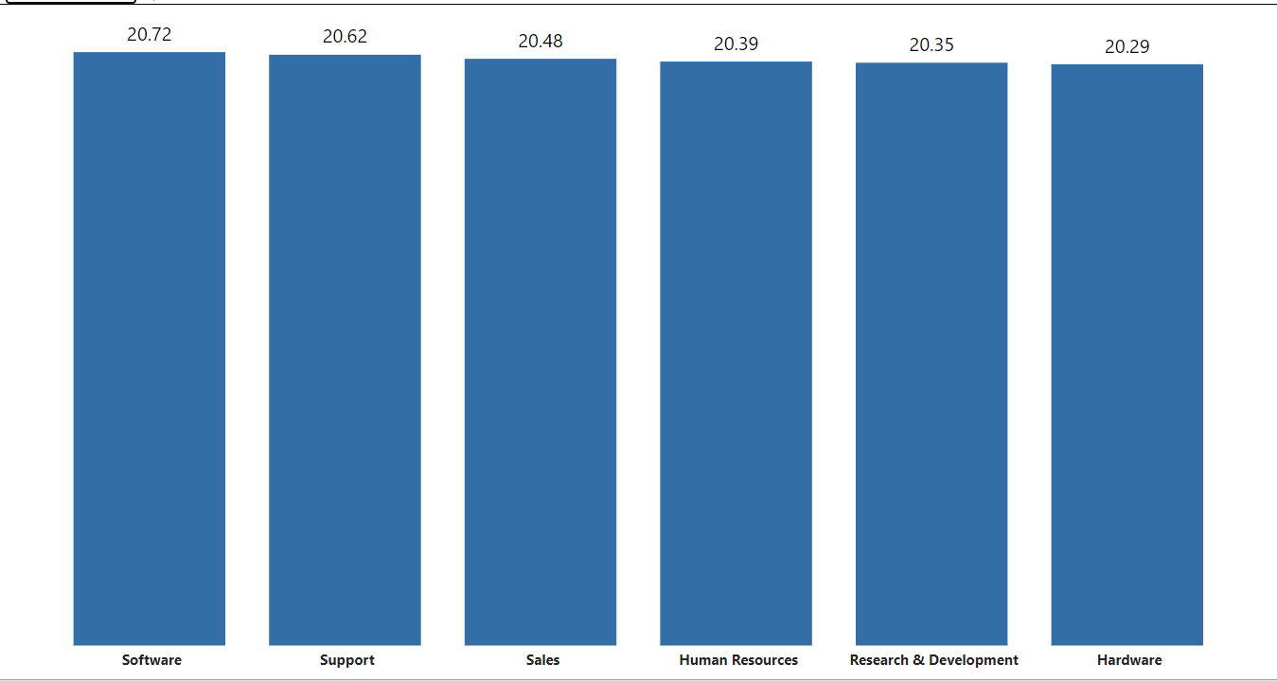
AVERAGE WORKING YEARS FOR EACH DEPARTMENT
From this we can see the average working years in software department is high as compared to the rest of the departments and lowest is for Research & Development Department. From the analysis we can conclude that average working years is approximately 20 for all the departments.

Slide 10
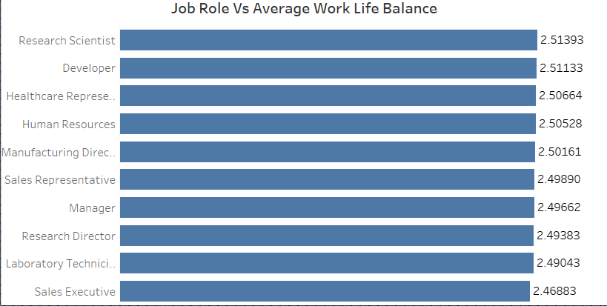
JOB ROLE Vs WORK LIFE BALANCE
From the analysis we can conclude that, For Research directors and the laboratory technicians the work life balance is poor. For the Sales representatives , managers , Manufacturing Directors and the Sales executives the work life balance is fair. For Research Scientists , Healthcare representatives und Developers the work life balance is good. For human resources the work life balance is excellent.

Slide 11
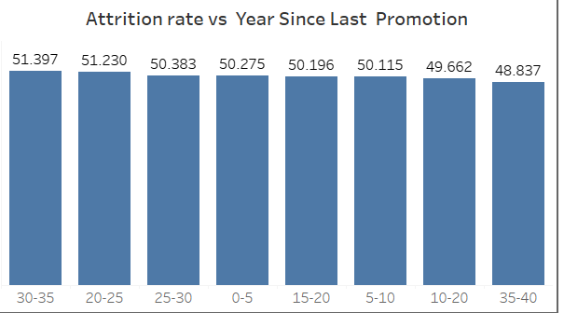
ATTRITION RATE Vs YEAR SINCE LAST PROMOTION RELATION
From the analysis and Visualization
For 0-5 years since Last year Promotion interval Research & Development and Hardware departments has highest and lowest attrition rate respectively.
For 6-10 years since last year promotion interval Human resources and software departments has highest and lowest attrition rate respectively.
For 11-15 years since last promotion interval support and sales departments has highest and lowest attrition rate respectively.
For 16-20 years since last promotion interval software & hardware departments has highest and lowest attrition respectively.
For 21-25 years since last promotion interval software and support departments has highest and lowest attrition respectively.
For 26-30 years since last promotion interval support and Human resources departments has highest and lowest attrition respectively.
For above 30 years since last promotion interval software and Human resources departments has highest and lowest attrition respectively.

Slide 12
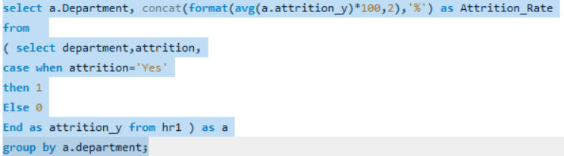
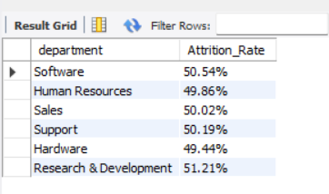
SQL KPI-1

Slide 13
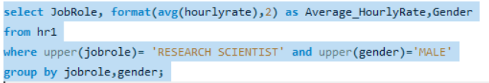
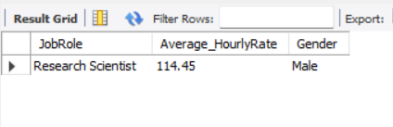
SQL KPI-2

Slide 14
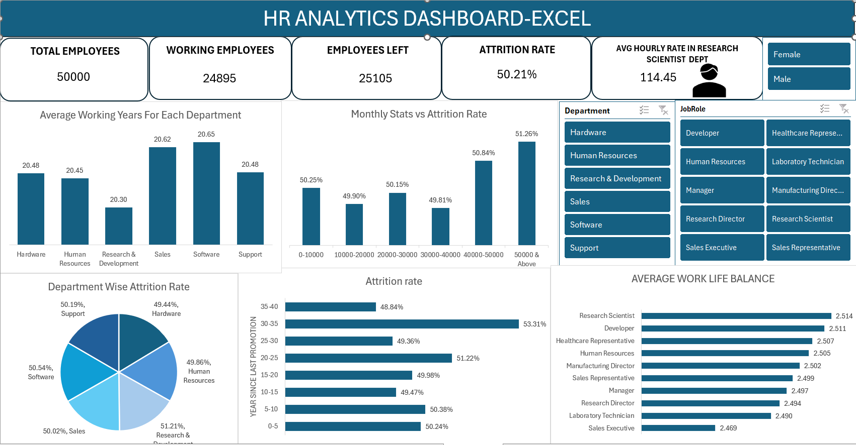

Slide 15
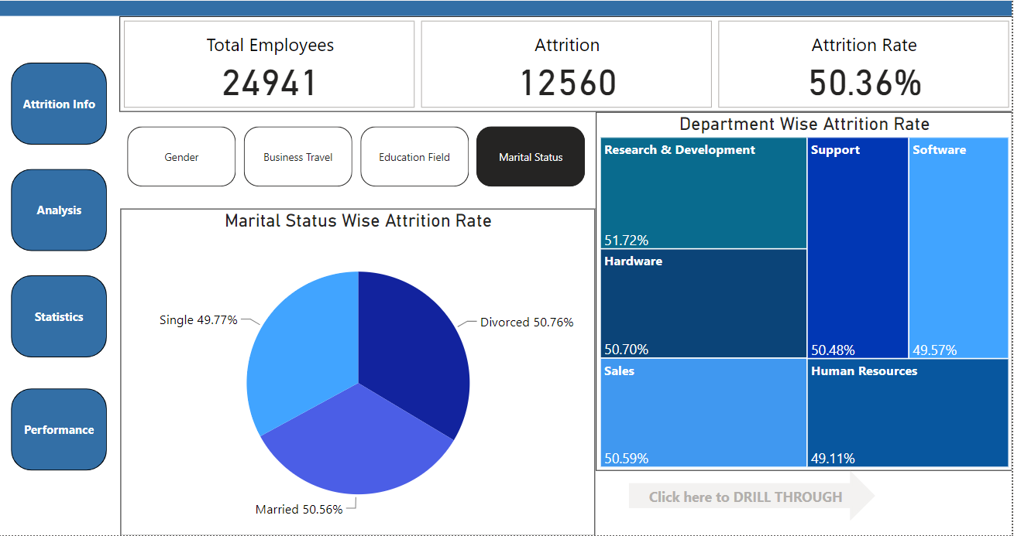

Slide 16
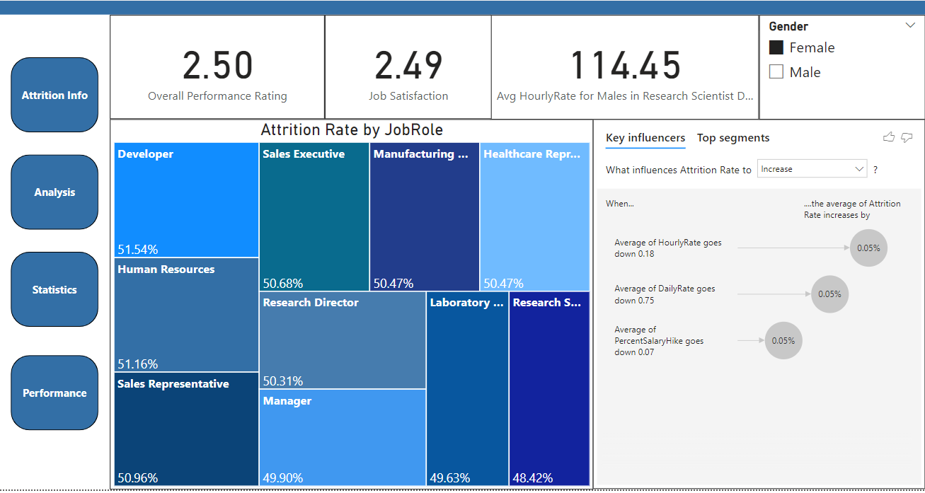

Slide 17
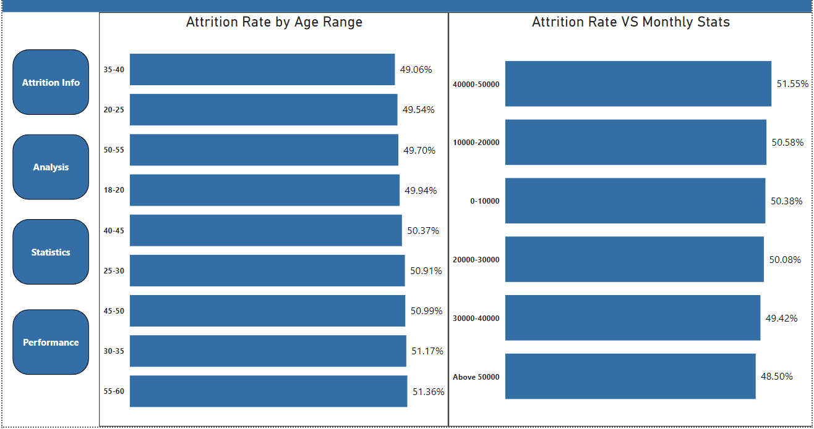

Slide 18
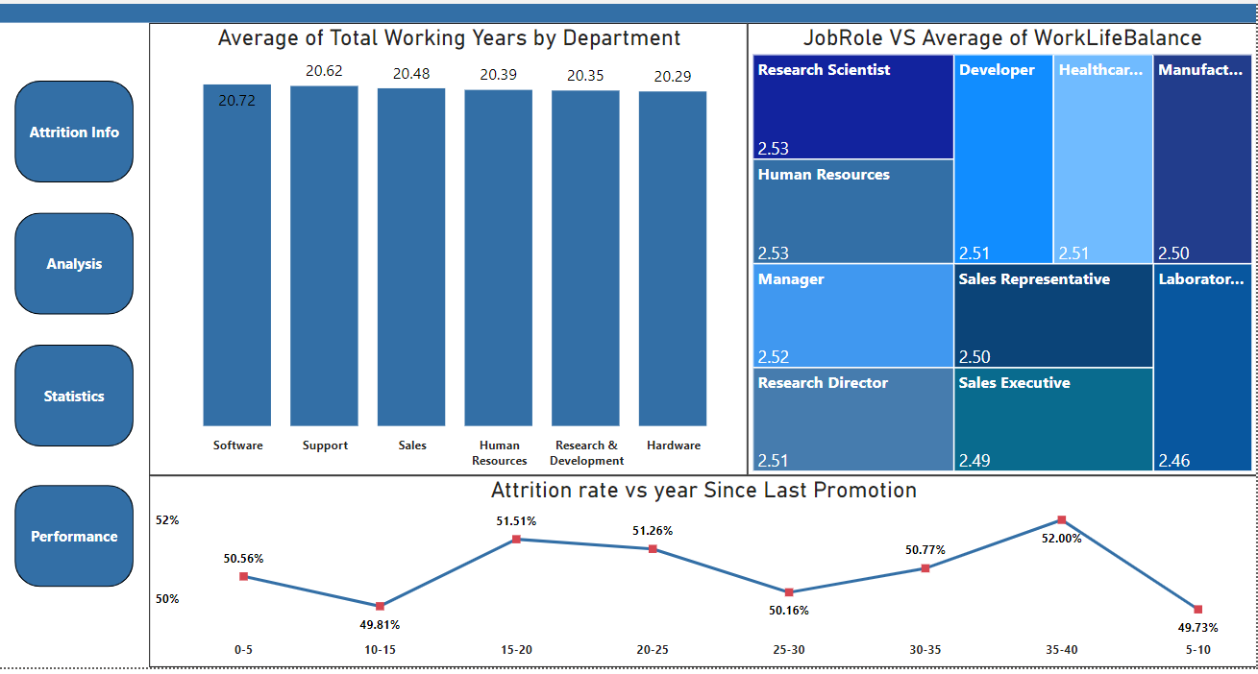

Slide 19
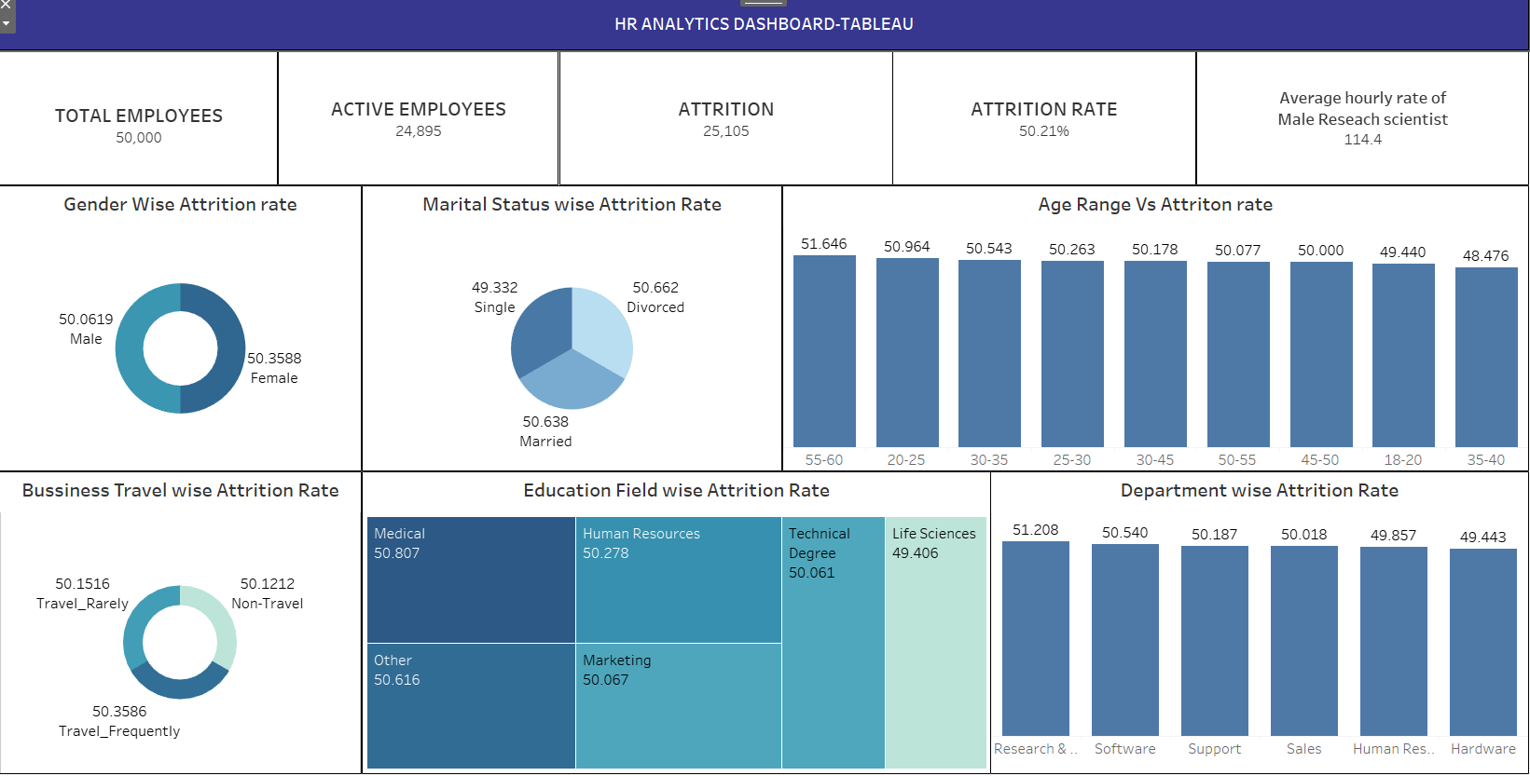

Slide 20
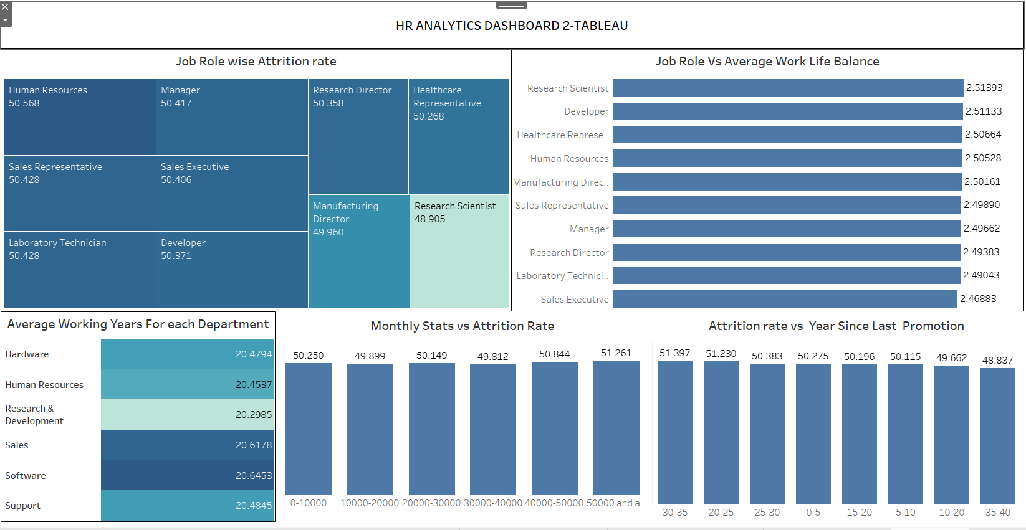

Slide 21
CONCLUSION
CONDUCT STAY INTERVIEWS: Instead of exit interviews, conduct stay interviews with employees to gather feedback about the job.
IMPROVE EMPLOYEE ENGAGEMENT: Implement initiatives to improve employee engagement, such as regular feedback, recognition and rewards programs, and opportunities for career growth.
ADDRESS WORKLOAD ISSUES: Ensure employees have manageable workloads by regularly monitoring and adjusting workloads to prevent burnout and overwhelm.
CREATE A POSITIVE WORK ENVIRONMENT: Foster a positive work environment by promoting a culture of respect, inclusivity, and teamwork. Encourage open communication and collaboration among employees.
ADDRESS PAY & COMPENSATION ISSUES: Ensure that employees receive fair pay and compensation for their work and to find out what motivates an employee to continue to work in an organization.

Slide 22
THANK YOU

